Slide 1
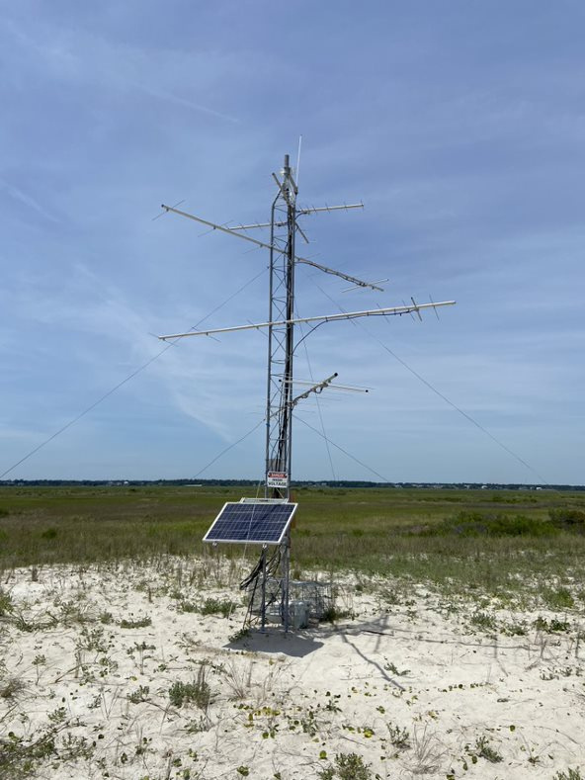
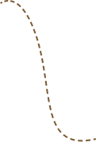
Migration and Motus Wildlife Tracking across the National Estuarine Research Reserve System
Moving From Place To Place

Slide 2
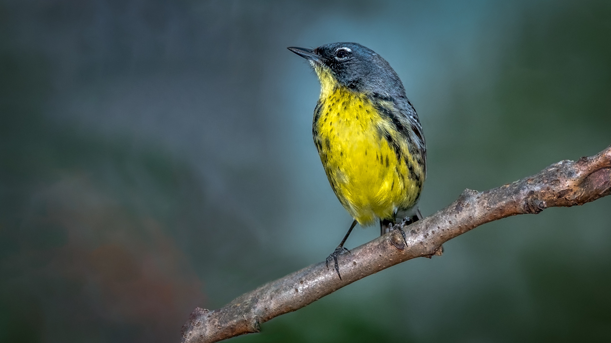

Learning Objectives
Learn about the Motus Wildlife Tracking System and its connection to the National Estuarine Research Reserve System (NERRS)
Engage with hands-on, creative, and collaborative activities to enhance the learning experience.
Develop scientific skills such as data analysis, critical thinking, and applying knowledge to make educated predictions in response to posed questions.

Slide 3
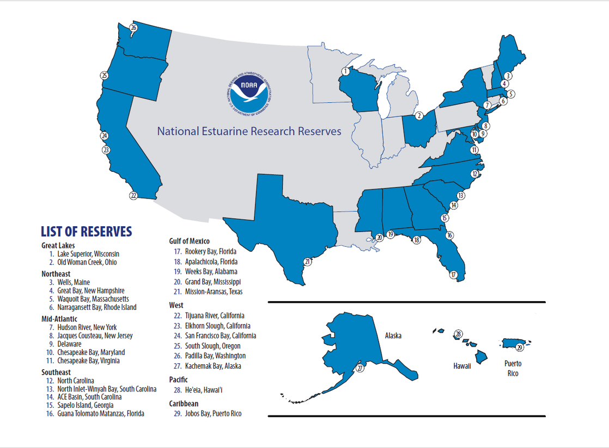

What is the nerrs
The National Estuarine Research Reserve System is a network of 30 coastal sites designated to protect and study estuarine systems in collaboration with and service to surrounding communities. Established through the Coastal Zone Management Act, this partnership program between NOAA and the coastal states supports ecosystem health and the interconnectedness of people and the environment.

Slide 4
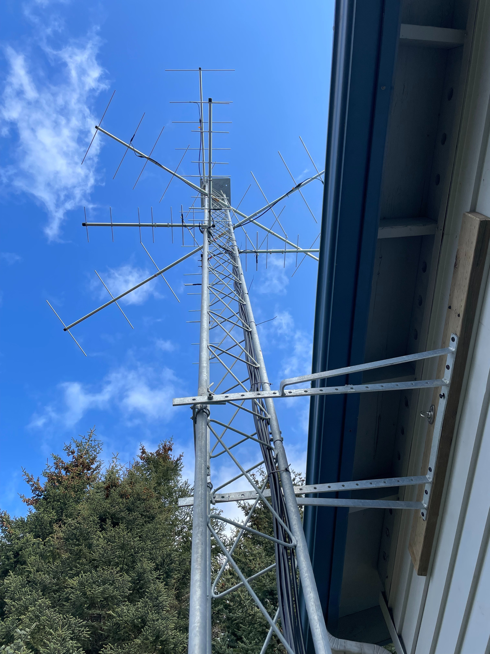
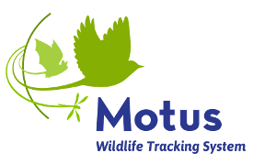
What is MOTUS ?
The Motus Wildlife Tracking System is a radiotelemetry-based system used to detect tagged animals and track their locations and times of detection
How does it work?
Who can use the data?

Slide 5
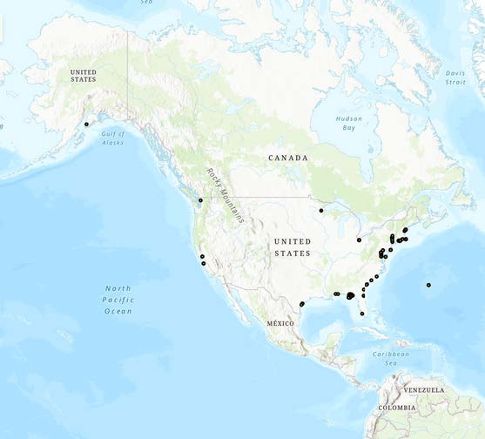
Motus and the Nerrs
The NERRS use the Motus system to study topics like migration patterns and flight speeds. Due to the significance of estuaries in the breeding and migration of coastal birds, Motus has greatly helped understand bird populations in the reserves. Knowledge gathered through Motus can then inform the NERRS to improve management and conservation practices!

Slide 6
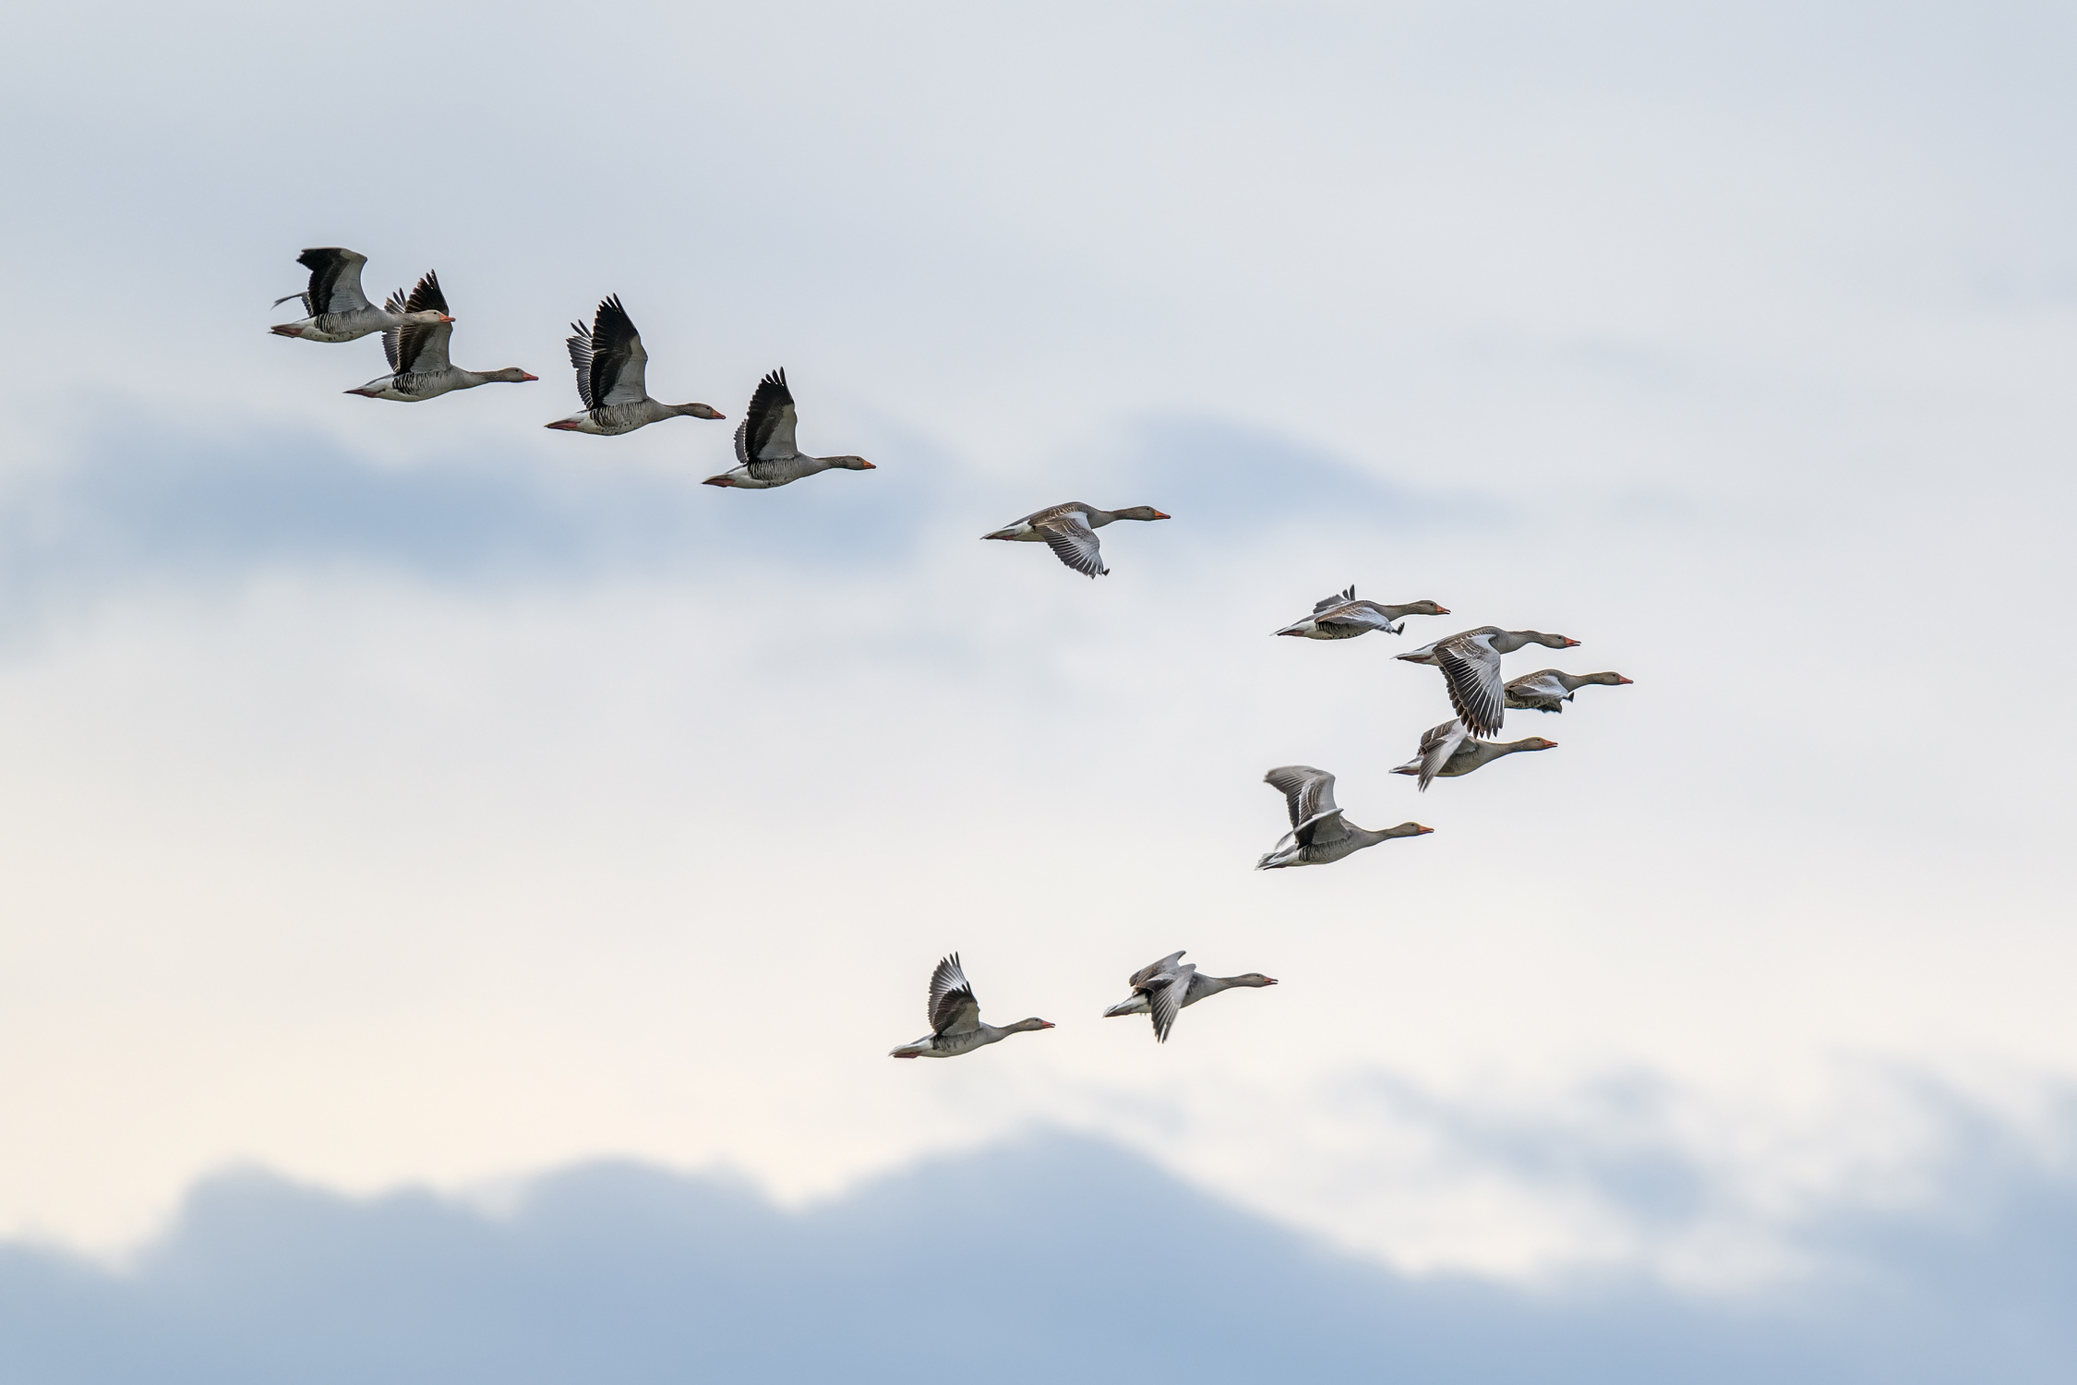
Migration
What is migration?
When does it occur?
What types of animals migrate?

Slide 7
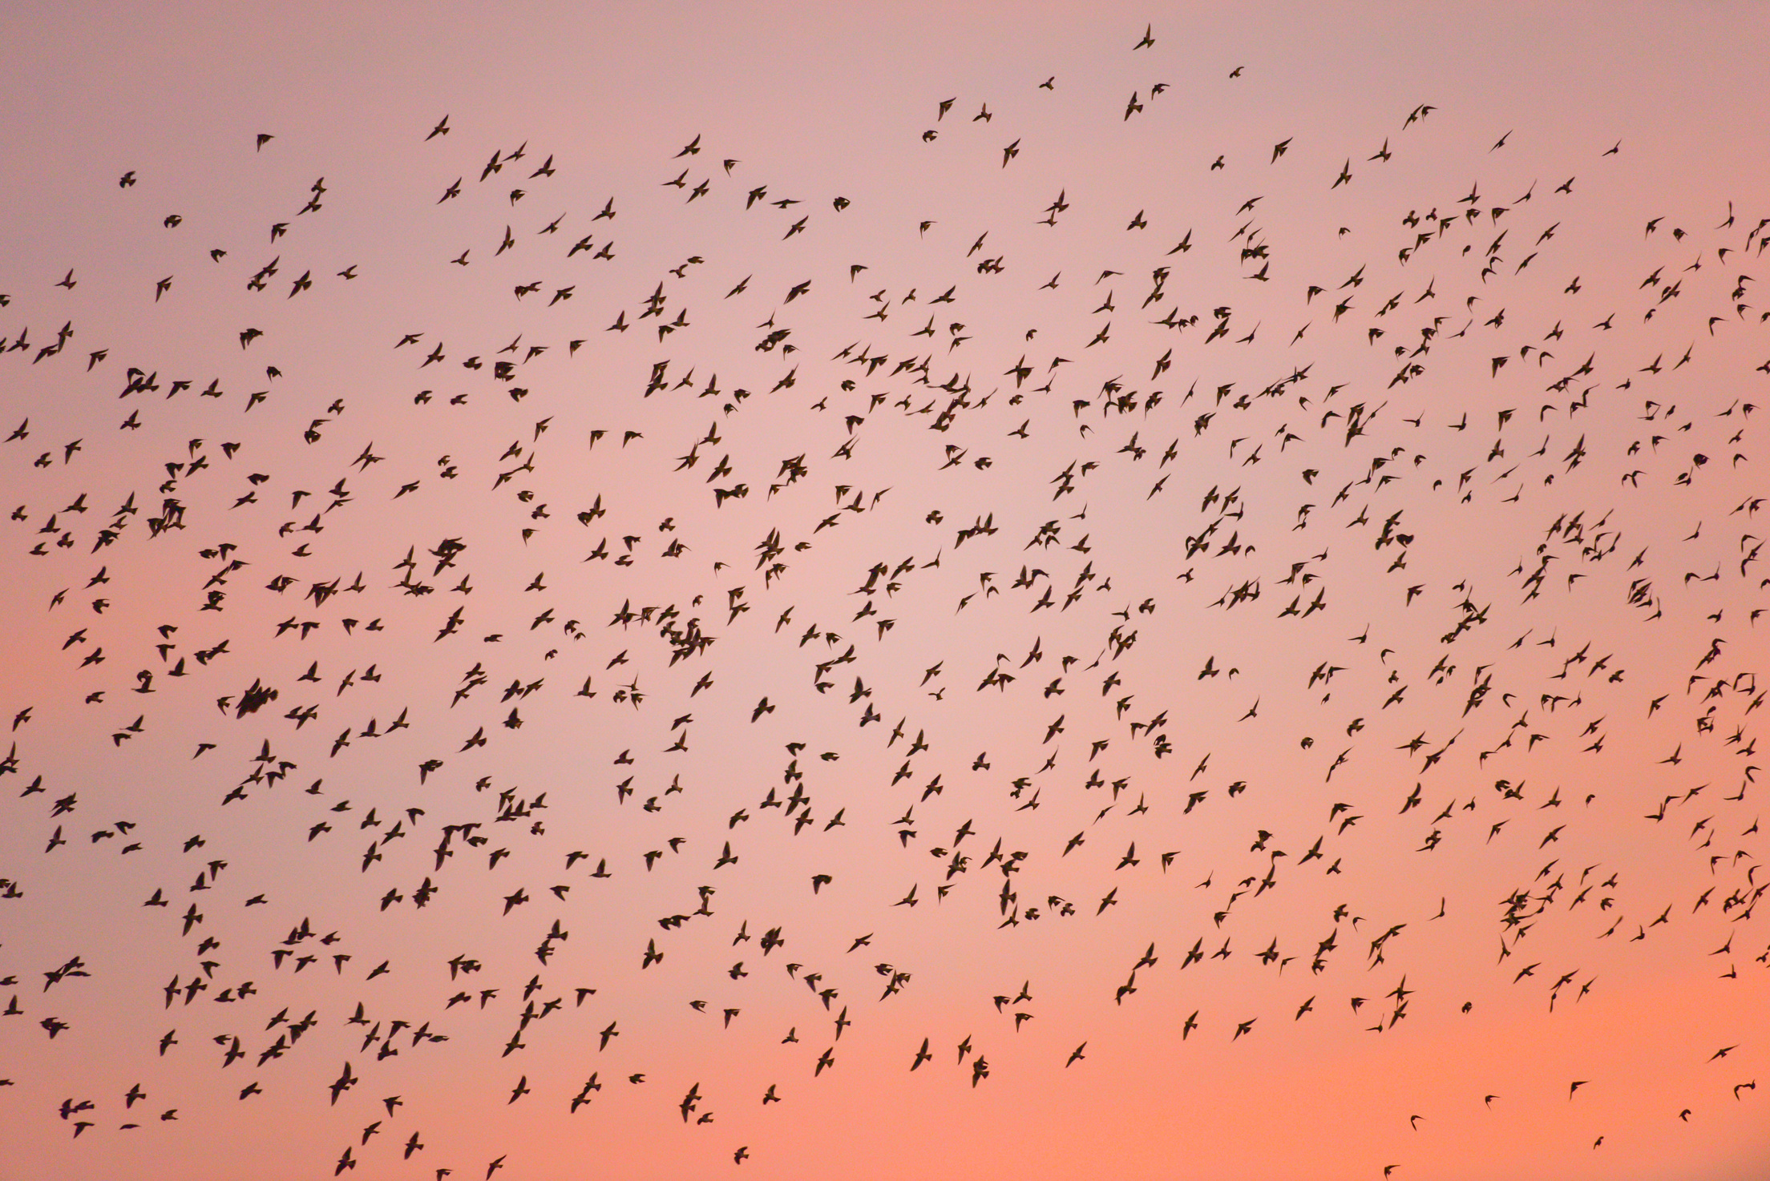
Migration ?
What are the benefits of migration to birds?
What could be potential challenges with migration?

Slide 8
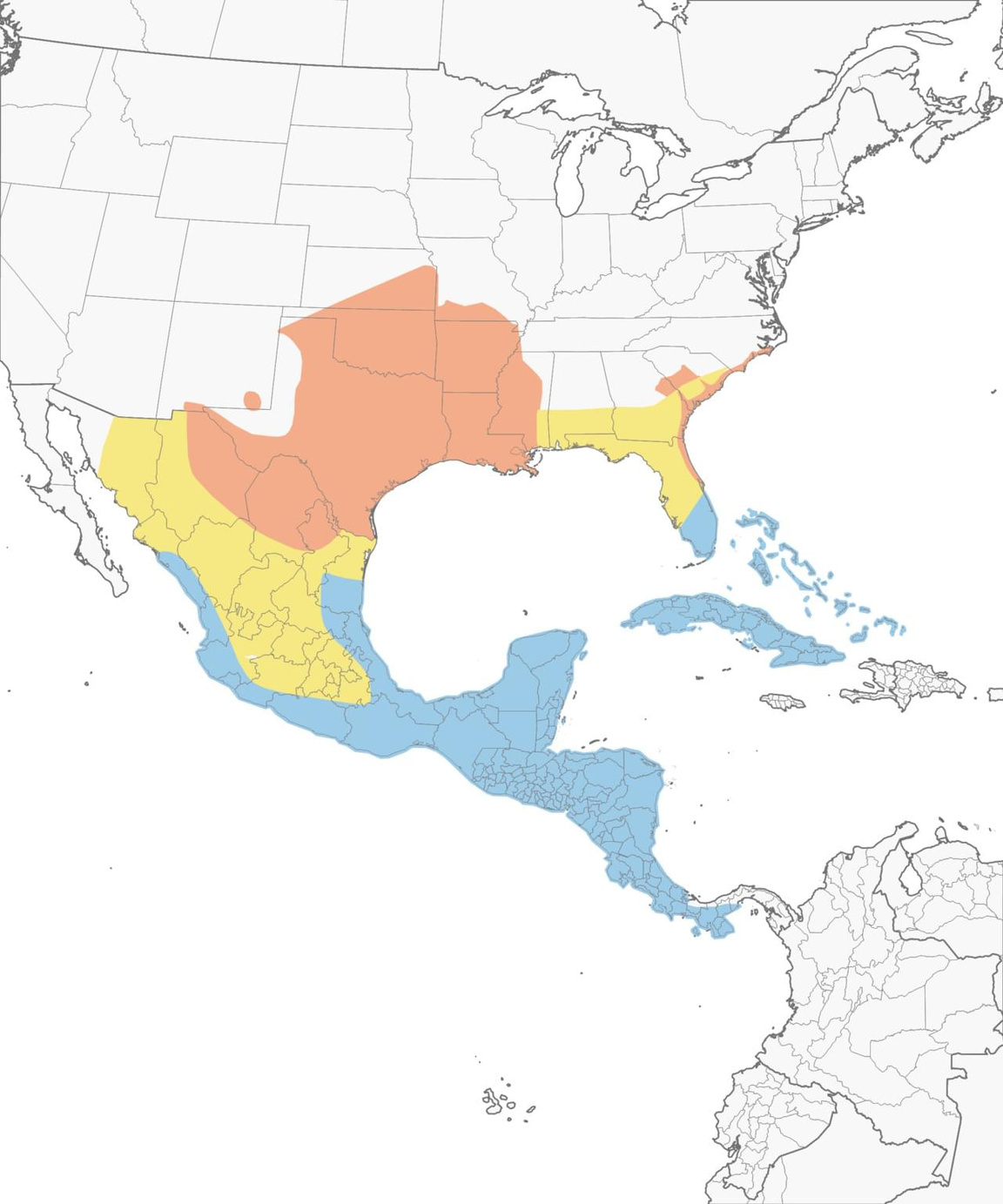
range
What is a species range?
How is range different for migratory species?

Slide 9
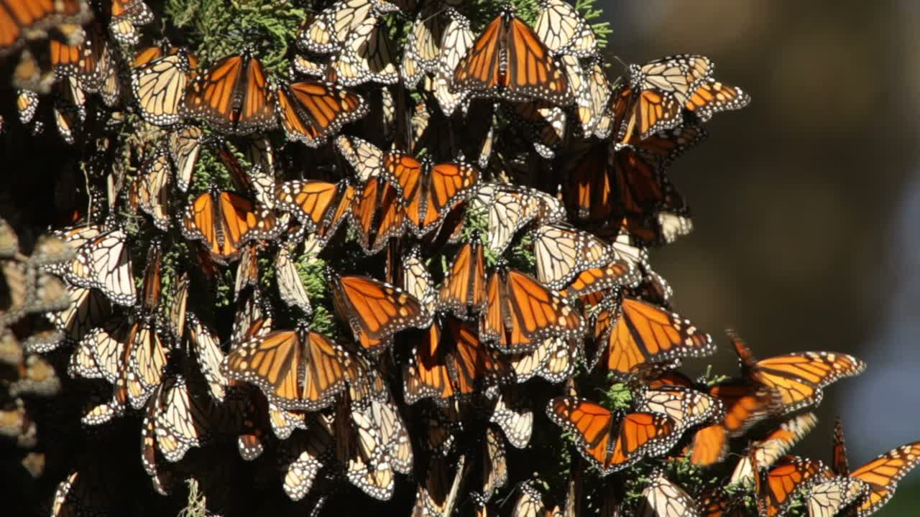
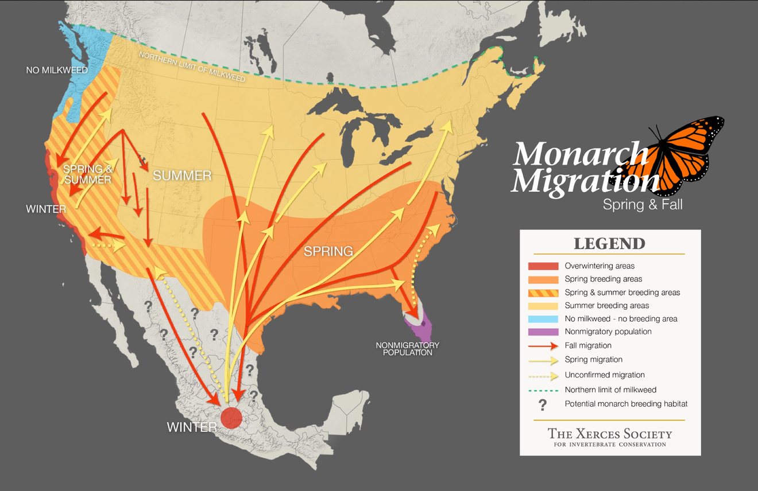
range Example
Monarchs

Slide 10
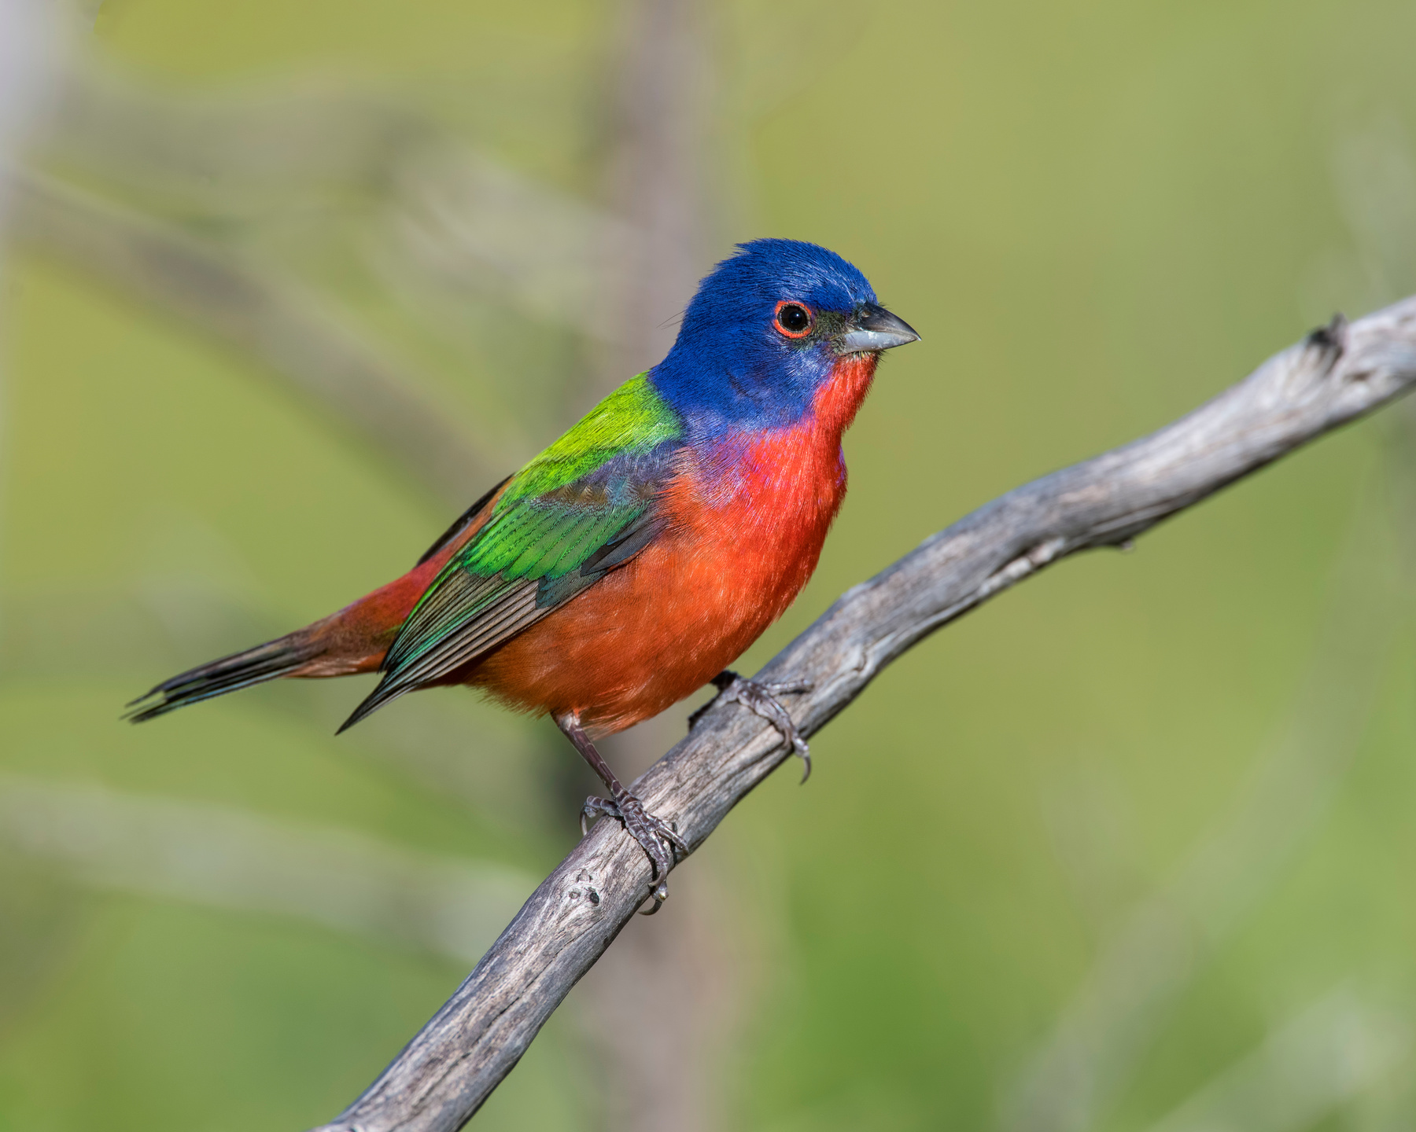
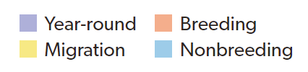
Painted Bunting
range Example

Slide 11
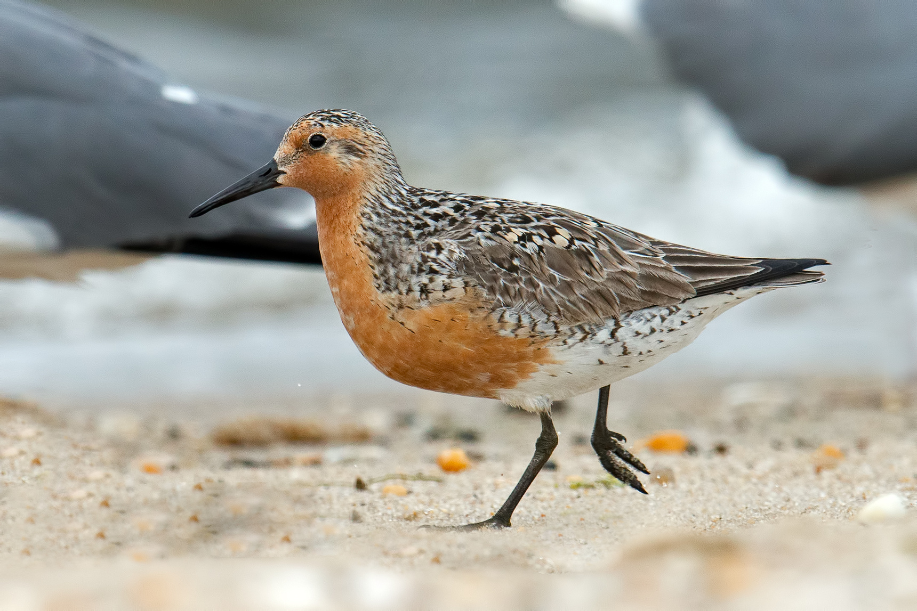

Conservation
Studying animal migration can help us better understand the natural world and inform conservation efforts to protect vulnerable species.Wildlife reserves and protected areas can provide safe havens for migrating animals to rest and feed along their journey.

Slide 12
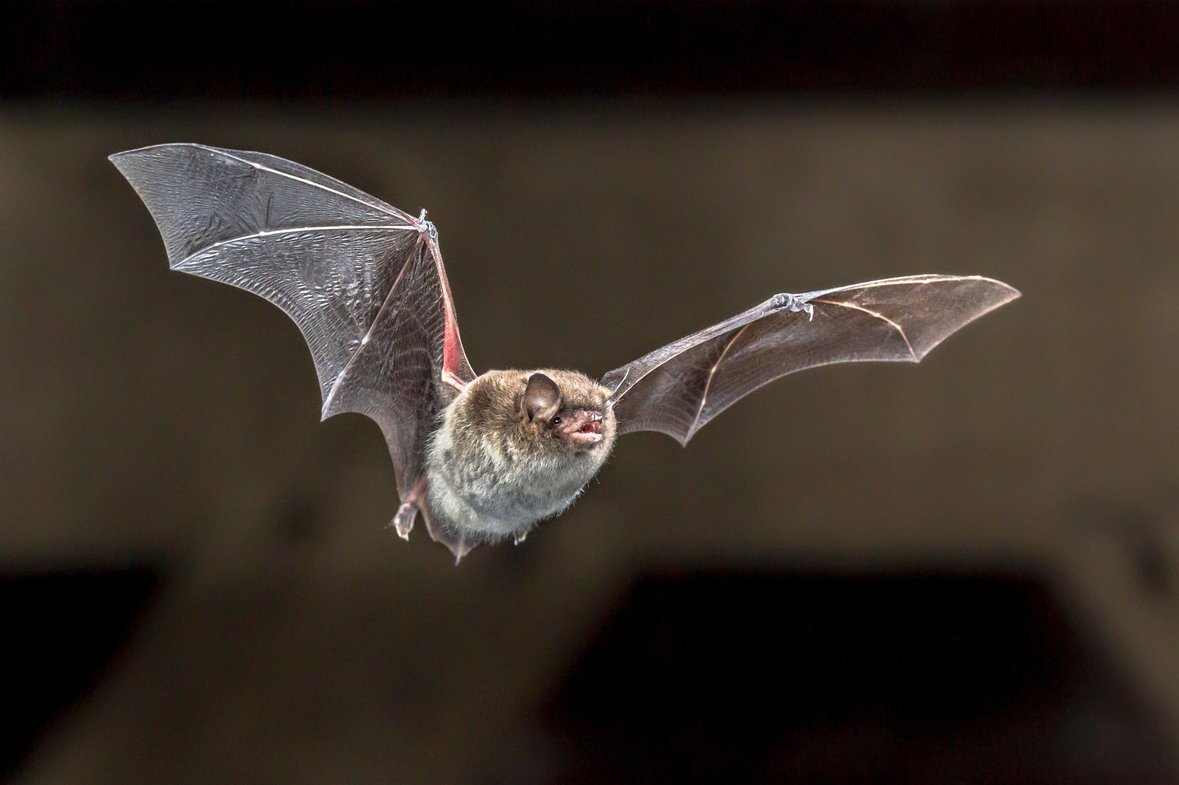
Conservation
How does Motus help conserve species?
How do NERRs help conserve bird species?

Slide 13
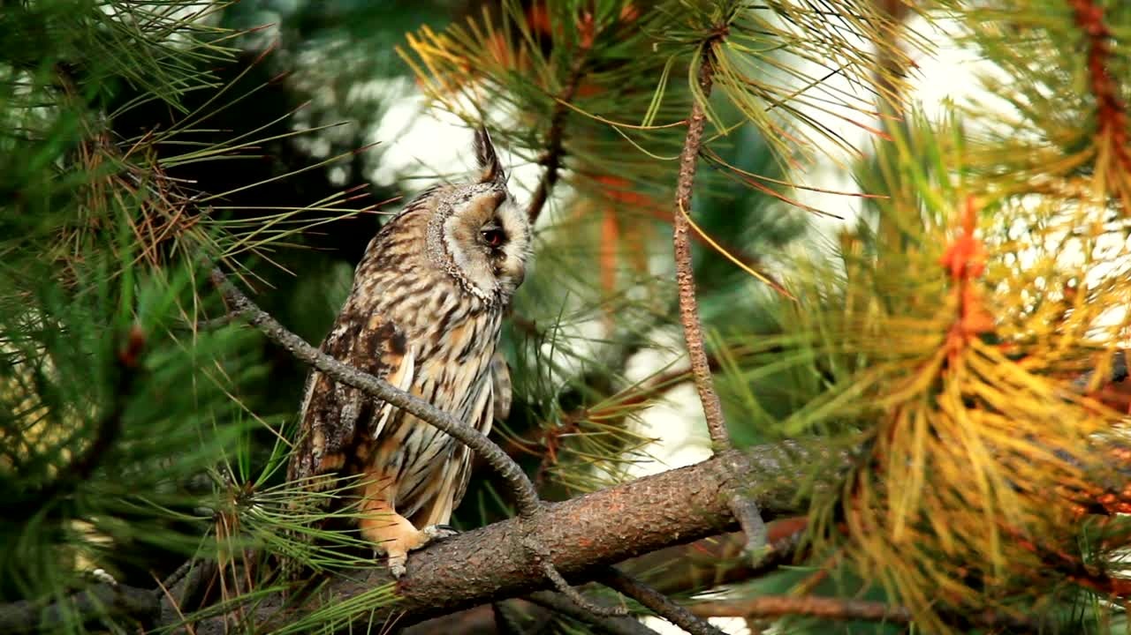
Conservation
Conventions for the Protection of Migratory Birds
North American Waterfowl Management Plan
Partners in Flight
U.S. Shorebird Conservation Plan

Slide 14
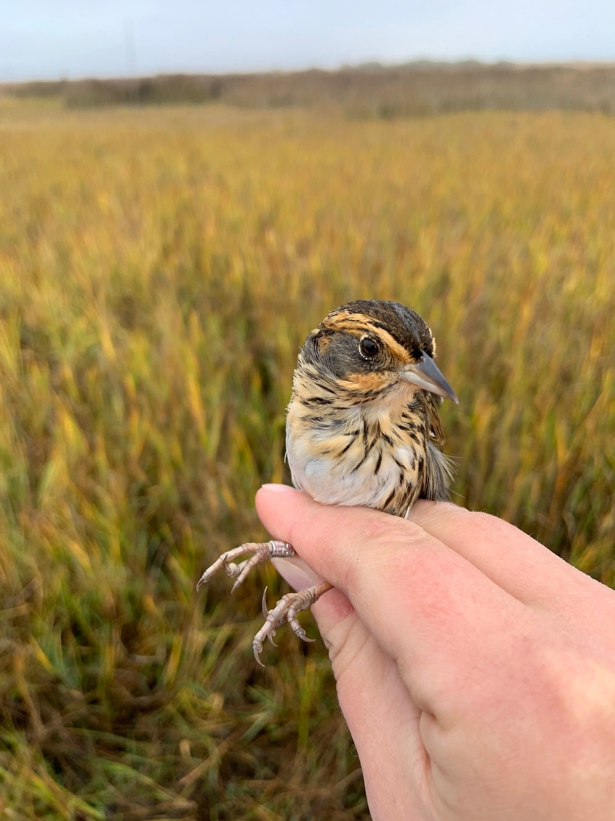
Conservation
What can you do to help conserve migratory species?

Slide 15
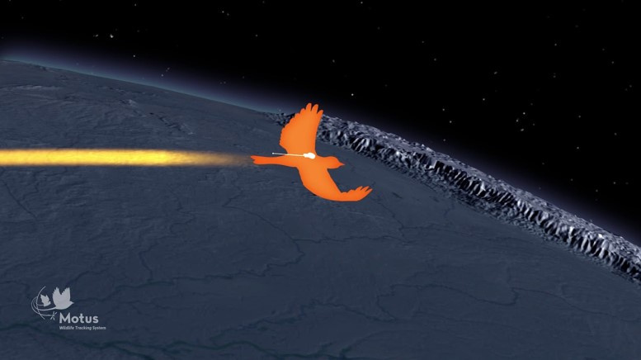
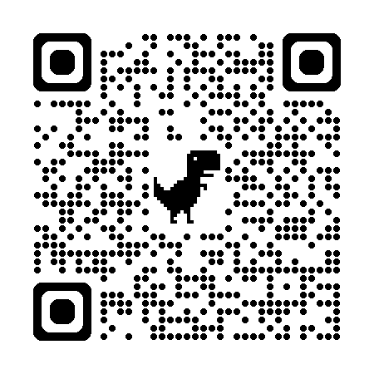
motus mysteries
Now lets investigate some Motus data!

Slide 16
motus mysteries
What surprises or interests you about this species?
Did you expect the species’ range to look like this? Why or why not?
Do you think the individual stayed in the area or moved on after detection?
Motus tracks are dependent on where towers are located. If you wanted to help elucidate more about this individuals migratory path, where would you suggest more towers be built?
What stands out about the individual’s flight path?
Do you believe the detections are accurate?

Slide 17
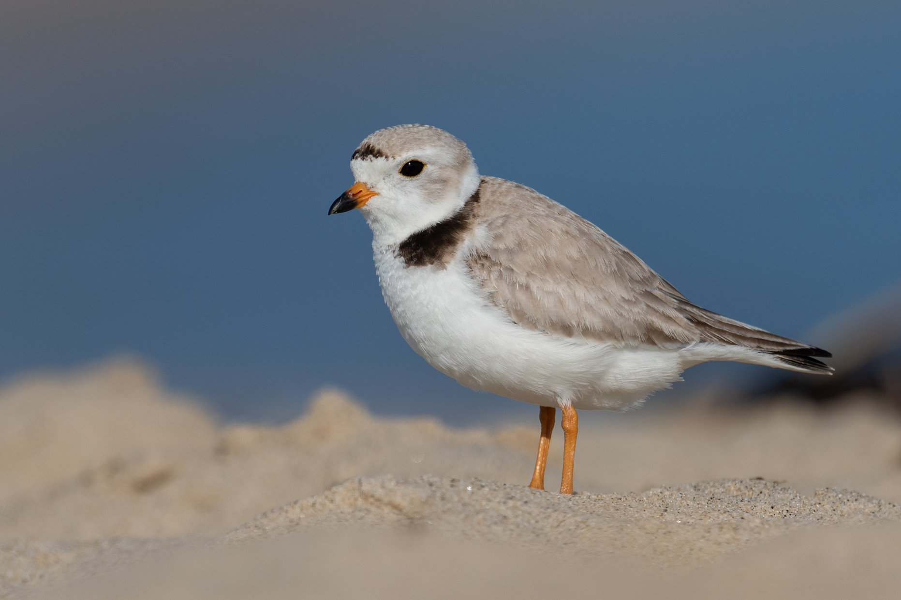
Working with motus data
Lets use the Motus dashboard to explore how Motus data is processed and presented on an open-source platform

Slide 18
Create Your Own Story and Present Motus Data
Select an individual animal to investigate.
Create a presentation (PowerPoint, poster, or map) that tells a narrative similar to "Motus Mysteries."
Essential Information to Include:
Picture of the species
Range of the species
Typical migration pattern (space and time)
Significant detections
Errors or unusual detections
Present to the group!

